Slide 1
Human Activity Recognition (HAR) – Battery Efficient Personalized Model
Submitted in the partial fulfillment for the award of the degree of
BACHELOR OF ENGINEERING
IN
COMPUTER SCIENCE WITH SPECIALIZATION IN
ARTIFICIAL INTELLIGENCE AND MACHINE LEARNING
NAME | UID
Tanjim Fahim | 22BAI71175 22BAI70447
Paraman | 22BAI71260
Under the Supervision of:
Department of AIT-CSE
DISCOVER . LEARN . EMPOWER

Slide 2
Outline
Introduction to Human Activity Recognition (HAR)
Background and Why This Problem Matters
Exact Problem Addressed in This Project
Objectives of the Study
Scope of the Work
Summary of Past Research and Gap Identified
System Architecture / Overall Working Process
Dataset Used and Preprocessing Steps
Selected Features and Battery-Efficient Design
Model Building: General vs Personalized Approach
Results and Performance Comparison
Conclusion and Future Improvements

Slide 3


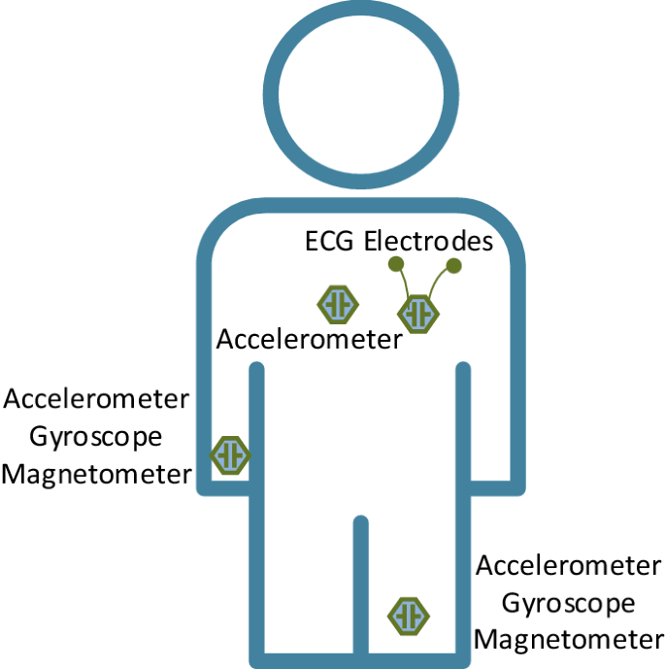

Introduction to Human Activity Recognition (HAR)
What is Human Activity Recognition (HAR)?
Client Needs & Requirements
Human Activity Recognition (HAR) is a computational technology that identifies and analyzes human movements and activities using sensor data from wearable devices or smartphones.
Industries developing fitness and healthcare applications face challenge of balancing model accuracy with energy efficiency, requiring models that function under low-power constraints without compromising recognition precision.
Core Components
Primary Sensors
• Sensor data collection • Feature extraction • Activity classification
• Accelerometers • Gyroscopes • Magnetometers
Market Growth & Significance
According to a 2024 market report, global wearable sensor market is projected to reach $7.5 billion by 2027, with HAR being one of its most significant application domains.
Key Applications
Critical Challenge
• Healthcare monitoring • Elderly assistance • Fitness tracking
Continuous sensor sampling drains 30-40% of battery capacity within hours if not optimized
Wearable sensors and accelerometers for HAR systems

Slide 4

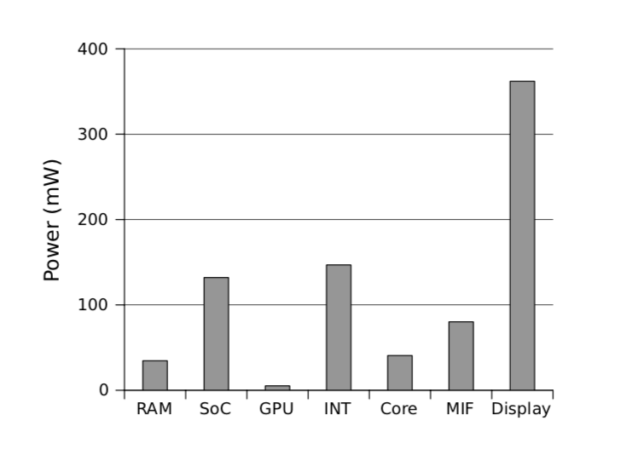

Background and Why This Problem Matters
Battery Consumption Crisis
The proliferation of wearable devices and smartphones has created a significant challenge: continuous HAR systems consume substantial battery resources, limiting their practical utility for long-term monitoring.
Energy Drain
User Experience Impact
Traditional HAR systems consume 30-40% of battery capacity within hours of continuous operation
Frequent recharging creates friction and reduces adoption of health-monitoring applications
Personalization Gap
Generic HAR models trained on diverse populations fail to capture individual movement patterns, resulting in decreased accuracy and user satisfaction.
Battery consumption breakdown in mobile devices
Inter-User Variability
Performance Degradation
Differences in body structure, gait patterns, and device placement create unique sensor signatures for each user
Generalized models exhibit 5-10% lower accuracy when applied to users not represented in training data

Slide 5


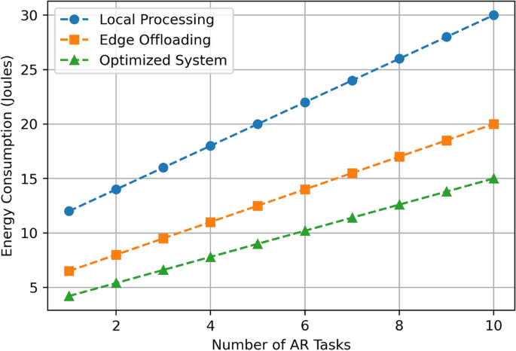
Exact Problem Addressed in This Project
Critical Constraints
Core Research Problem
The solution must operate within strict limitations of consumer-grade mobile hardware while delivering real-time, accurate activity classification.
The fundamental challenge is designing HAR models that maintain high recognition accuracy while operating efficiently on resource-constrained, battery-powered mobile and wearable devices.
How can HAR models balance accuracy with energy efficiency without compromising user experience?
Battery Life
Processing Power
Maximum 30% of total battery capacity allocation for continuous operation
Compatible with standard smartphone CPUs and wearable microcontrollers
Computational Complexity
Feature Overload
Deep learning models (CNNs, LSTMs) demand substantial processing power, causing rapid battery depletion
Traditional HAR systems rely on high-dimensional features (FFT, Jerk, Mag) that are computationally expensive
Sensor Redundancy
Lack of Adaptability
Multiple sensors (accelerometer, gyroscope, magnetometer) significantly increase energy consumption
Generalized models fail to accommodate individual movement patterns and device placement variations
Energy consumption comparison between different HAR systems

Slide 6


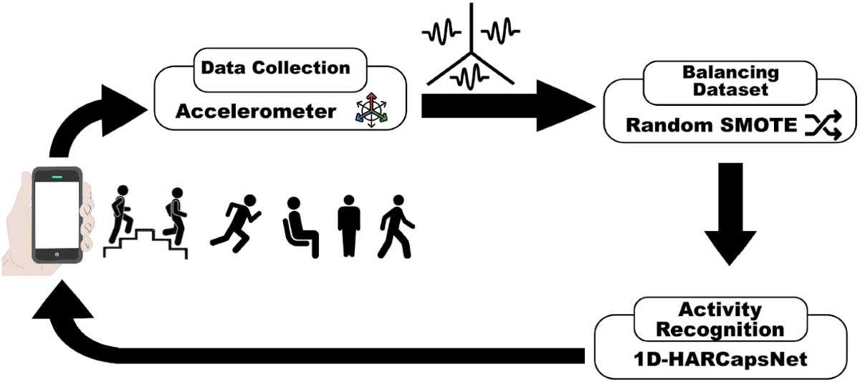






Objectives of Study
Primary Goal
Expected Outcomes
To develop an energy-efficient, personalized HAR framework suitable for real-time use on smartphones and wearable devices while maintaining high recognition accuracy.
The system aims to achieve an average of 7% improvement in recognition accuracy while consuming significantly less power than standard models, making it viable for long-term mobile and wearable deployment.
Specific Objectives
Dataset Acquisition
Feature Optimization
Collect and preprocess publicly available accelerometer data representing diverse human activities
Extract and identify essential statistical and temporal features to minimize computational load
Model Development
User Personalization
Design lightweight classifiers for both general and personalized models
Implement user-specific fine-tuning to capture individual motion patterns
Energy Efficiency
Integrate adaptive sampling mechanisms to regulate sensor frequency and measure battery savings
Performance Analysis
Evaluate accuracy, precision, recall, and F1-score between general and personalized models
Activity recognition process with feature extraction and classification

Slide 7





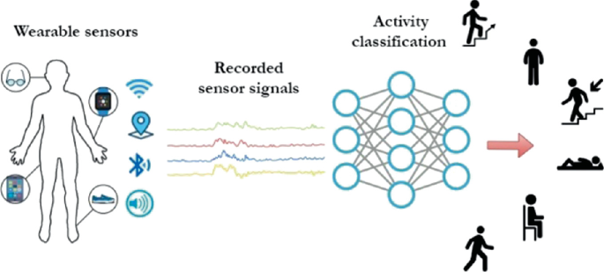
Scope of Work
Project Boundaries
Out of Scope
This research focuses on developing a battery-efficient HAR system using only accelerometer data, with emphasis on personalized models that adapt to individual user patterns while maintaining computational efficiency.
Advanced Activities
Multi-Sensor Integration
Complex activities like sports, dancing, or specific medical conditions detection
Systems requiring gyroscope, magnetometer, or other sensor combinations
In Scope
Real-time Cloud Processing
Hardware Implementation
Solutions that rely on continuous cloud connectivity for computation
Custom hardware development or sensor design
Activity Classification
Sensor Data
Six basic activities: walking, walking upstairs, walking downstairs, sitting, standing, and laying
Tri-axial accelerometer readings from smartphones and wearable devices
Feature Engineering
Model Comparison
Time-domain statistical features: mean, standard deviation, correlation, entropy
General model vs. personalized models with accuracy and energy consumption metrics
Scope of wearable sensor-based activity recognition

Slide 8





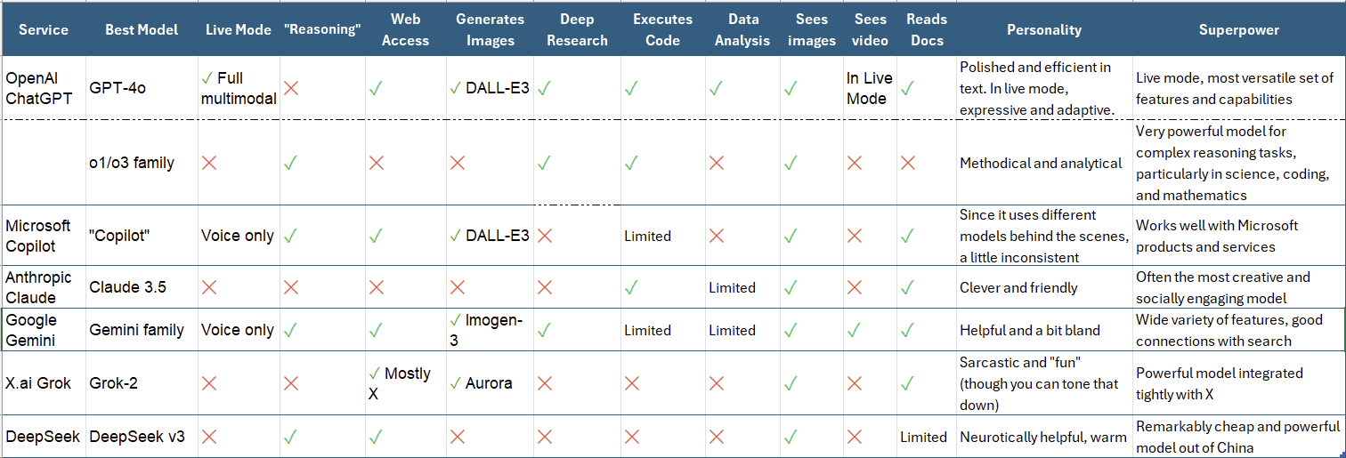
Summary of Past Research and Gap Identified
Evolution of HAR Research
Existing Approaches & Limitations
Early Research (1990s-2004)
Mobile Era (2010-2015)
• Laboratory-controlled environments • Bulky sensors & motion capture • First practical accelerometer-based HAR (Bao & Intille)
• Multiple onboard sensors emergence • Natural environment data collection • Energy consumption challenges identified
While deep learning approaches achieve high accuracy, they require substantial computational resources. Conversely, lightweight models conserve energy but often sacrifice recognition precision.
Feature Engineering
Machine Learning Models
Efficiency Focus (2016-2018)
Personalization Era (2019-2024)
• Handcrafted features, PCA, LDA • Dimensionality reduction • Manual feature selection limitations
• Lightweight algorithms (Logistic Regression) • Deep learning (CNNs, LSTMs) • Computational cost vs. accuracy trade-off
• Adaptive sampling strategies • Compressed classification • Deep learning accuracy vs. power trade-off
• User-specific model fine-tuning • On-device intelligence • Lightweight frameworks for embedded systems
Research Gap Identified
No current solution simultaneously optimizes accuracy, energy efficiency, and personalization. Existing research focuses on individual aspects rather than an integrated approach that balances all three critical factors.
Evolution of HAR research approaches and methodologies

Slide 9


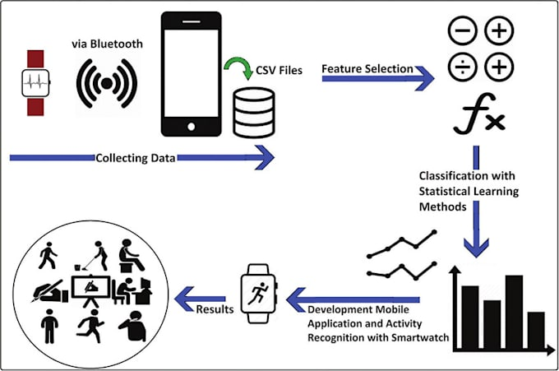
System Architecture / Overall Working Process
System Architecture
Working Process Overview
The architecture consists of four primary stages: Data Acquisition → Feature Extraction & Selection → Model Training and Personalization → Performance Evaluation. Each stage is designed to minimize energy consumption while maximizing recognition accuracy.
The proposed system follows a modular pipeline designed to optimize both recognition accuracy and energy efficiency through a personalized approach.
1
Data Collection
2
Battery-Efficient Feature Extraction
Energy Optimization Strategy
Only essential statistical features (mean, std) retained to minimize computational load
The system employs a two-tier optimization approach: feature-level optimization by selecting only computationally efficient features, and runtime optimization through adaptive sampling.
Tri-axial accelerometer signals collected from smartphones and wearable devices
3
Model Selection
4
Adaptive Sampling
Hybrid approach: general model for new users, personalized models after calibration
Dynamic adjustment of sensor frequency based on detected activity intensity
Smartwatch data collection and analysis pipeline

Slide 10


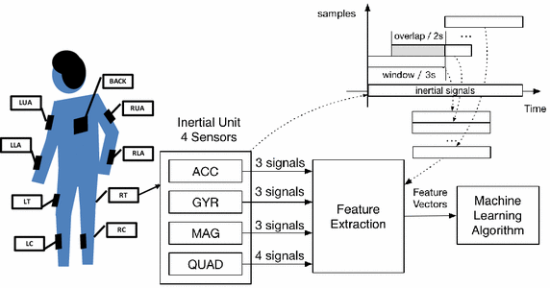




Dataset Used and Preprocessing Steps
Dataset Characteristics
Data Splitting Strategy
The study utilized a publicly available HAR dataset containing tri-axial accelerometer readings from multiple subjects performing six distinct activities.
For general model evaluation, GroupShuffleSplit was employed to ensure all data from a single subject resides in either training or test set, simulating real-world scenarios with unseen users.
6
30
3
Personalized Models
Stratified Sampling
Activities
Subjects
Sensor Axes
Individual 80/20 split for each subject's data
Ensures balanced representation of all activity classes
Preprocessing Pipeline
Data Merging
Noise Removal
Train and test files concatenated using pandas for unified processing
Low-pass filtering applied to eliminate high-frequency noise
Normalization
Label Encoding
Z-score normalization to ensure zero mean and unit variance
Activity classes encoded for machine learning compatibility
Sensor data preprocessing workflow for HAR systems

Slide 11


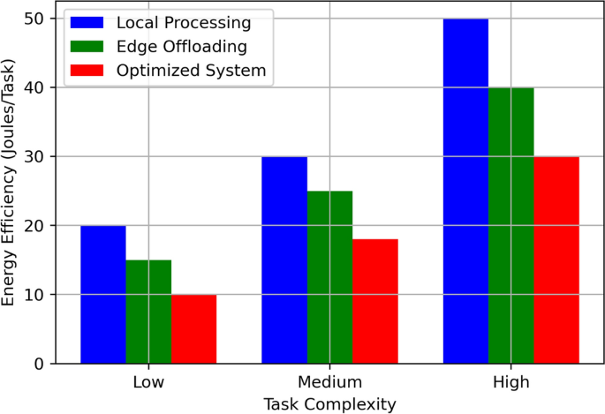


Selected Features and Battery-Efficient Design
Battery-Efficient Feature Selection
60%
40%
85%
The feature selection process prioritized computational efficiency while maintaining predictive power, focusing on only the most informative statistical features from accelerometer signals.
Battery Life Extension
Computational Reduction
Feature Information Retention
Retained Features
Removed Features
mean()
std()
Body acceleration
FFT components
Jerk
Magnitude
Subject ID
Activity Label
Angle features
Gravity components
Energy Optimization Strategies
The system employs a two-tier optimization approach: feature-level optimization through selective feature extraction and runtime optimization via adaptive sampling.
Adaptive Sampling
Computational Efficiency
• Lower frequency during static activities • Higher frequency during dynamic activities • Reduces redundant data collection by 50-60%
• Eliminates expensive FFT operations • Removes derivative calculations • Reduces model training time by 40%
Energy efficiency comparison between different feature sets

Slide 12




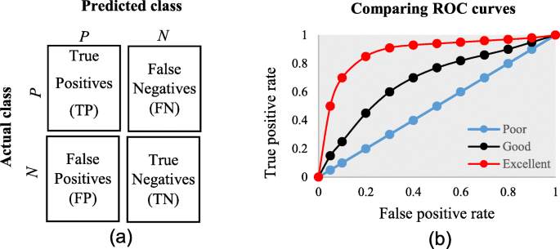
Model Building: General vs Personalized Approach
General Model
Personalized Model
Hybrid Approach
Phase
Model
Purpose
Architecture
Architecture
Day 1
General Model
Immediate "cold start" with 83.9% accuracy
Single model trained on diverse population data
Individual models for each user
Personal 80/20 train-test split per user
Group-wise data splitting to prevent leakage
Days 1-2
Data Collection
Passive gathering of user-specific data
Lighter LightGBM (50 estimators, depth 4)
LightGBMClassifier with 100 estimators
Max depth of 6 for complexity balance
Captures unique movement patterns
Day 3+
Personalized Model
Hyper-accurate recognition with 90.8% accuracy
Advantages
Advantages
Simple deployment (one model file)
Higher accuracy across all activity classes
Immediate "cold start" capability
Reduced computational requirements
Performance: 90.8% accuracy
Works for any user without calibration
Limitations
Limitations
Lower accuracy for unique movement patterns
Complex deployment (N models)
Requires calibration period for new users
Performance: 83.9% accuracy

Slide 13


Results and Performance Comparison
7%
60%
90.8%
Accuracy Improvement
Battery Life Extension
Personalized Model Accuracy
Personalized vs. General
Through Adaptive Sampling
Average Across Users
Model Performance Comparison
Accuracy Comparison
Metric
General Model
Personalized Model
Accuracy
83.9%
90.8%
F1-Score
0.84
0.90
83.9%
90.8%
General Model
Personalized Model
Energy Use
100%
65%
Key Findings
Personalized models outperformed general models for nearly 90% of subjects
Adaptive sampling reduced energy consumption by 50-60% without compromising recognition reliability
Highest accuracy recorded for Subject 24 (93.5%), demonstrating excellent adaptation to user behavior

Slide 14

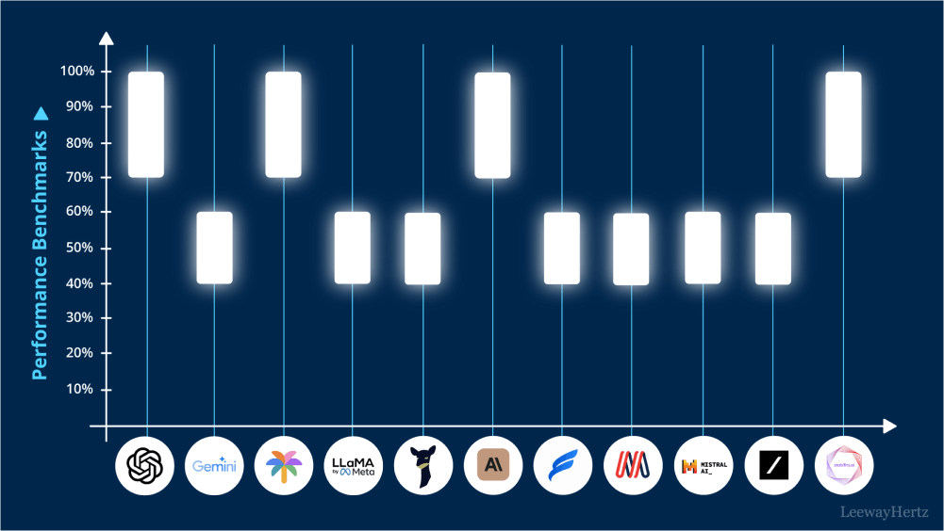





Conclusion and Future Improvements
Key Achievements
The research successfully developed a battery-efficient, personalized HAR framework that balances accuracy with energy consumption, demonstrating significant improvements over conventional approaches.
Energy Efficiency
Personalization
Adaptive sampling reduced battery consumption by 50-60% without compromising recognition reliability
User-specific models achieved 7% higher accuracy compared to generalized models
Computational Efficiency
Practical Deployment
Feature selection reduced computational load by 40% while maintaining predictive power
System designed for real-time operation on standard smartphones and wearables
Future Improvements
While current implementation demonstrates significant advancements, several areas offer opportunities for further enhancement and research.
Future directions in HAR research
Advanced Personalization
Multi-Modal Integration
Exploring meta-learning and transfer learning techniques to reduce calibration time
Selective incorporation of additional sensors for specific activity classes
Context Awareness
Edge-Cloud Hybrid
Integration of environmental context to improve classification accuracy
Developing adaptive offloading strategies for computationally intensive activities

